Slide 1
MANAGEMENT INFORMATION SYSTEMS
Chapter 6: Databases and Information Management

Slide 2

Fireship (2025, October 21). US-EAST-1 is humanity’s weakest link… [Video]. YouTube. https://youtu.be/HqL0xhwDz9s?si=DExF-U0CYsW0zAdb

Slide 3
Recap of Chapter 5
Discuss IT infrastructure and its evolution
Describe the components of IT infrastructure
Discuss the mobile platform, apps, and BYOD
Discuss quantum computing and green computing
Discuss virtualization and cloud computing
Discuss IT infrastructure management challenges

Slide 4
Traditional Data
Management Problems

Slide 5

Data Management Problems
Effective information systems must provide accurate, timely, and relevant information.
Accurate: Free from errors.
Timely: Available when decision-makers need it.
Relevant: Useful and appropriate for the task or decision.
Many firms fail to achieve this due to poorly organized or maintained data.
Poorly managed data limit managers’ ability to make evidence-based decisions.
Understanding these issues begins with how data are organized in traditional file systems.

Slide 6
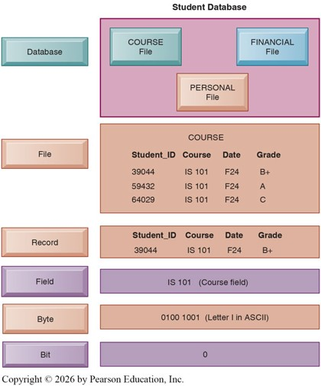
File Organization Terms and Concepts
Data are organized hierarchically:
Bit (binary digit): Smallest unit (0 or 1).
Byte: Group of bits representing one character.
Field: Group of characters representing a data item (e.g., Name, Age).
Record: Group of related fields describing one entity.
File: Group of records of the same type.
Database: Group of related files.

Slide 7
Problems in the Traditional File Environment
Early information systems grew independently in each department.
Functional areas (Accounting, HR, Marketing, etc.) developed separate applications and data files.
As a result, hundreds of isolated files and programs existed across the firm, leading to problems such as:
Data redundancy and inconsistency
Program-data dependence
Lack of flexibility
Poor security
Lack of data sharing and availability

Slide 8
Problems: Data Redundancy and Inconsistency
Data Redundancy: Same data stored in multiple places.
Data Inconsistency: Same attribute has conflicting values.
Occurs when departments independently collect and store data.
e.g. Student_ID field might appear as “Student_ID” in one system and “ID” in another.
e.g. Clothing size might appear as “extra-large” in one system and “XL” in another.
Consequences:
Leads to conflicting reports and uncertainty about which data are correct.
Causes inefficient storage and duplication of effort.
Reduces managers’ confidence in data used for decision making.

Slide 9
Case Study: Walmart and Data Redundancy
Source: https://www.mbaknol.com/management-case-studies/case-study-of-walmart-inventory-management/
Problem: Data Redundancy
The same product could appear under multiple SKUs or descriptions (e.g., ‘32 oz. Detergent’ vs. ‘D32-LQ’).
Separate databases at stores and warehouses made real-time inventory updates impossible.
Headquarters often received conflicting stock counts from different systems, complicating procurement and demand forecasting.
Conflicting data made it difficult to forecast demand or coordinate procurement.
What are the anticipated impacts of data redundancy in this scenario?
Before its full supply-chain digitization, Walmart’s inventory systems were partly decentralized across stores, distribution centers, and regional operations. Each location maintained its own inventory files and item codes, often using different data formats and reporting standards.

Slide 10
Case Study: Walmart and Data Redundancy
Source: https://www.mbaknol.com/management-case-studies/case-study-of-walmart-inventory-management/
Impact:
Inventory planning became less accurate, leading to stockouts in some stores and overstocking in others.
Managers had to reconcile data manually, increasing both labor and communication costs.
The lack of unified data visibility slowed companywide decision-making and reporting.
How could Walmart address this problem?
Before its full supply-chain digitization, Walmart’s inventory systems were partly decentralized across stores, distribution centers, and regional operations. Each location maintained its own inventory files and item codes, often using different data formats and reporting standards.

Slide 11
Case Study: Walmart and Data Redundancy
Source: https://www.mbaknol.com/management-case-studies/case-study-of-walmart-inventory-management/
Solutions:
Walmart implemented a centralized enterprise database integrated with barcode scanning, POS systems, and RFID technology.
Real-time data sharing between stores, suppliers, and logistics teams replaced redundant local files.
The new system improved accuracy, reduced manual data handling, and enabled instant visibility across the supply chain.
Centralizing data eliminated redundancy and inconsistency, enabling Walmart to improve efficiency, forecasting accuracy, and responsiveness to consumer demand.
Before its full supply-chain digitization, Walmart’s inventory systems were partly decentralized across stores, distribution centers, and regional operations. Each location maintained its own inventory files and item codes, often using different data formats and reporting standards.

Slide 12
Problems: Program-Data Dependence
Data Dependence: Data being tightly coupled with the programs that use them.
Each application must define where and how data are stored.
Any change in data structure requires reprogramming multiple systems.
e.g. Expanding ZIP codes from 5 to 9 digits requires rewriting all related programs.
Consequences:
Leads to high maintenance costs whenever programs or data formats change.
Creates system rigidity, making updates slow and expensive.
Delays new system development or integration projects.

Slide 13

Problems: Lack of Flexibility
Traditional systems handle routine, pre-defined reports well.
But ad hoc or unexpected requests require manual programming.
Consequences:
Prevents managers from generating ad hoc or customized reports quickly.
Results in slower responses to emerging business needs.
Reduces an organization’s ability to adapt to change.

Slide 14

Problems: Poor Security
Decentralized files lead to weak or inconsistent control.
Consequences:
Increases risk of unauthorized access or data corruption.
Makes it difficult to track or audit data usage.
Weakens compliance and accountability across departments.

Slide 15

Problems: Lack of Data Sharing and Availability
Data in separate files cannot easily be related or combined.
Consequences:
Creates information silos and duplication of effort.
Limits cross-departmental collaboration and insights.
Produces inconsistent or delayed reporting, eroding trust in data.

Slide 16
Database Management Systems

Slide 17
Database Management Systems (DBMS)
A Database is a collection of data organized to serve many applications efficiently.
Centralizes data and controls redundancy across the organization.
A single database can support multiple applications (e.g., personnel, payroll, benefits).
Users experience data as if stored in one unified location.
A Database Management System is software that:
Centralizes data and manages access efficiently.
Acts as an interface between applications and data files.
Retrieves requested data items (e.g., gross pay) and delivers them to programs.
The DBMS eliminates the need for programmers to manage data formats and locations manually.

Slide 18
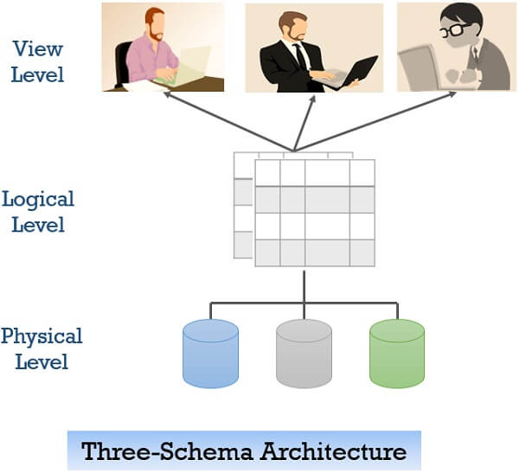
Database Management Systems (DBMS)
The DBMS separates how data are logically viewed from how they are physically stored.
Logical View: How data appear to end users.
Physical View: How data are structured on storage media.
Different employees can access different “views” from one database.
Simplifies use, protects sensitive data, and reduces errors.

Slide 19
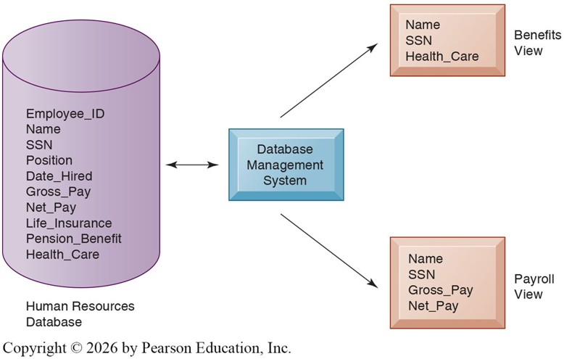
Example DBMS: HR Database Views
Benefits Specialist can view employees’ names, SSN, health coverage.
Payroll Department can access employees’ names, SSN, gross pay, net pay.
Both draw from the same centralized employee database.
Simplifies access while maintaining data consistency.

Slide 20
How a DBMS Solves Traditional Problems
Reduces data redundancy and inconsistency.
Decouples programs and data, so updates to data do not require rewriting programs.
Improves data access and availability through ad hoc queries.
Lowers maintenance costs and supports faster development.
Centralizes control of data use and security.
Enables easier data sharing across the organization.

Slide 21
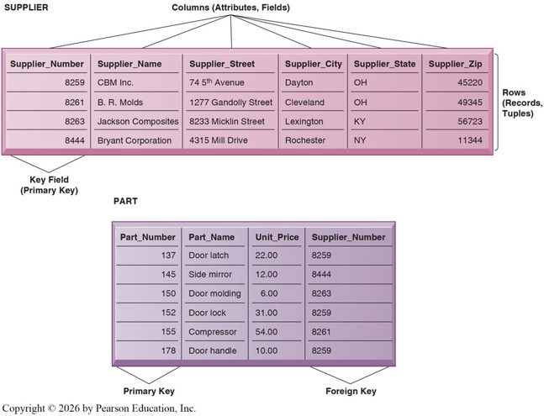
Relational Databases: The Modern Standard
Contemporary DBMS use different database models to keep track of entities, attributes, and relationships
The most common DBMS model is the Relational Database.
Organizes data into two-dimensional tables (relations).
Each table stores data about one entity (e.g., SUPPLIER, PART).
Each Row = Record
Each Column = Field (attribute).

Slide 22
Relational Databases: Keys and Relationships
Key Field: A field in a record that uniquely identifies instances of that record.
Primary Key: Uniquely identifies each record in a specific table.
Foreign Key: A field in one table that links to the primary key of another.
These relationships enable tables to be connected flexibly.

Slide 23
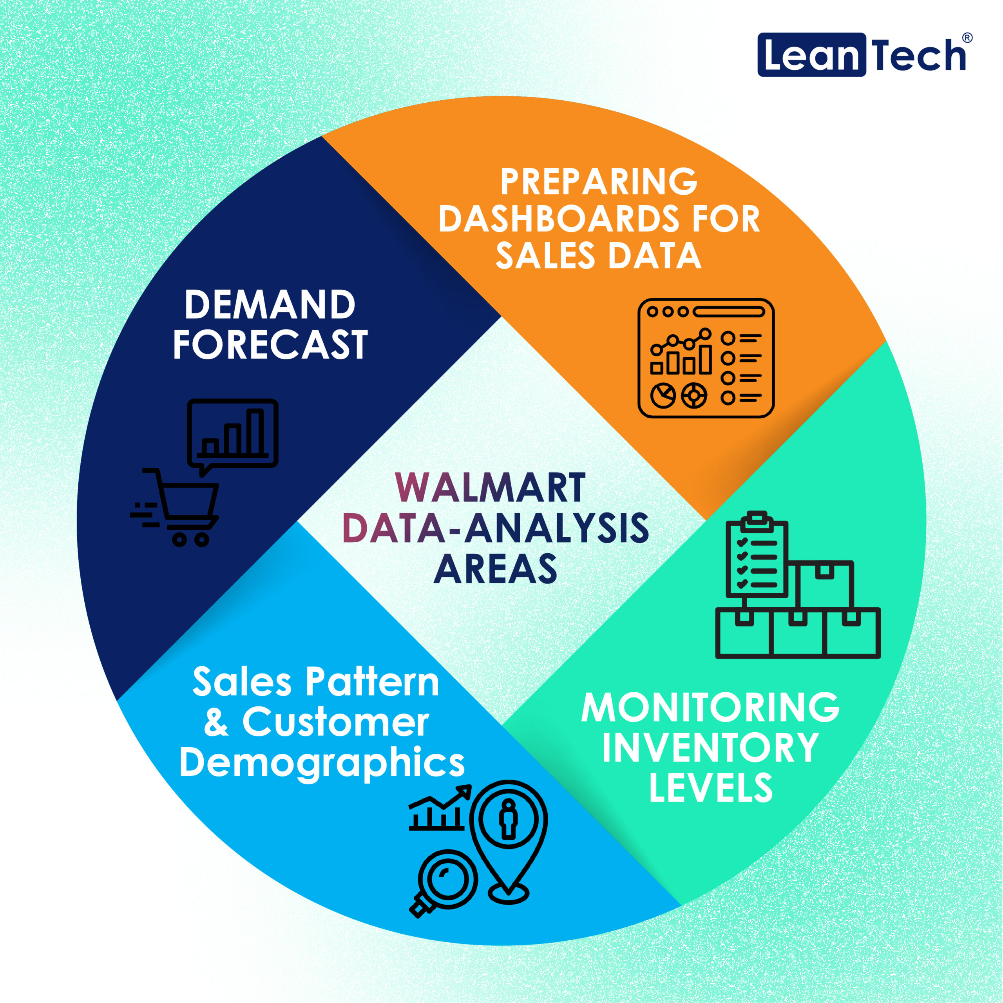
Example: Walmart’s Data Centralization
Walmart once had separate databases for stores and warehouses.
This caused duplicate records and inconsistent stock information.
By centralizing inventory data in one DBMS, Walmart:
Reduced errors and manual reconciliation.
Improved demand forecasting and logistics.
Enabled real-time visibility across all locations.
Takeaway: Centralized data leads to faster, more informed business decisions.

Slide 24
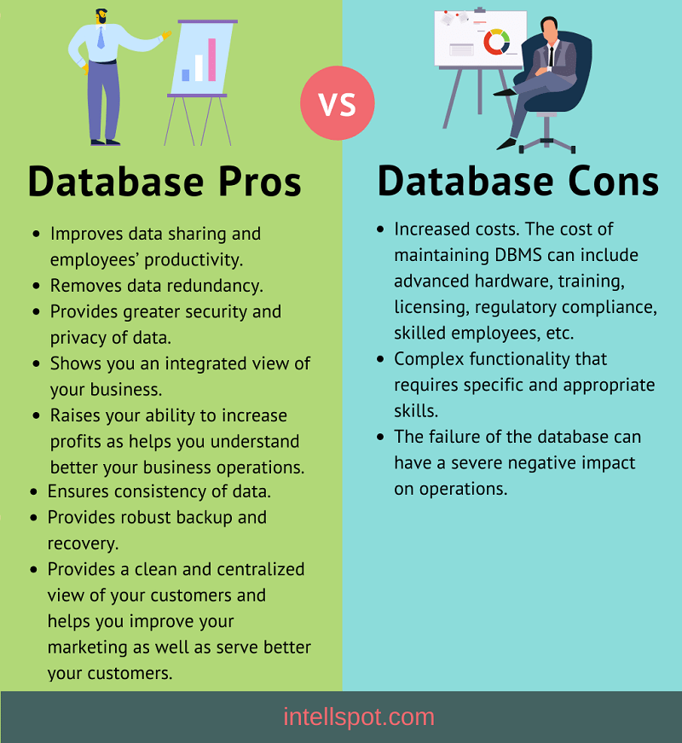
How Businesses Use DBMS Tools
DBMS power systems managers already use daily:
CRM (Customer Relationship Management)
ERP (Enterprise Resource Planning)
HR and Payroll Systems
Managers can create reports or “ask questions” (query) without programming.
The system finds and combines the data automatically.
Managers can filter, group, summarize data in reports.
Support budgeting, forecasting, and tracking.
Think of it as a smarter version of MS Excel, one source, many answers.

Slide 25
Database Design and
New Database Technologies

Slide 26
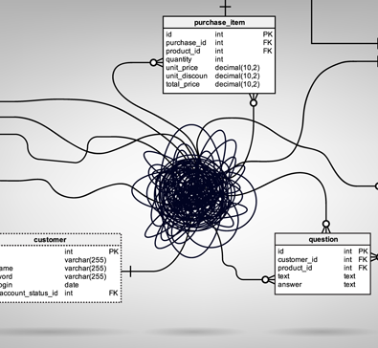
Why Database Design Matters
A good database starts with understanding:
What types of data the organization needs.
How those data relate to one another.
How different departments will use and share them.
Goal: Build a system that supports the whole organization, not just one unit.
Poor design leads to missing, duplicated, or inconsistent information and bad decisions.
“If we don’t define our data clearly, every report will tell a different story.”

Slide 27

Example: Globe and Mail
Canada’s Globe and Mail once stored subscriber and prospect data in multiple systems.
Data were fragmented across mainframes, Access files, and Excel sheets.
Marketing teams couldn’t cross-reference subscribers with prospects for campaigns.
Result: duplicated work, poor targeting, and missed revenue opportunities.
A central, well-designed database later fixed these problems by creating one shared source of truth.

Slide 28
Database Design and Managers
Poor database design doesn’t just slow systems, it affects critical business functions.
Database design has two levels:
Conceptual (logical): How data connect from a business perspective.
Physical: How data are actually stored by IT systems.
The conceptual view is most important for managers, as it defines what data mean and who uses them.
Managers and IT must collaborate to ensure the structure reflects real business needs.
Good database design is less about technology and more about business clarity.
The goal is to ensure that every department works with the same, trusted information.

Slide 29
Why New Database Technologies Matter
Businesses now deal with data that are:
Bigger: Massive volumes from online and mobile activity
Faster: Real-time web services and transactions
Complex: Text, images, video, social media, sensors
Traditional relational databases can’t always handle these demands.
New solutions provide flexibility, scalability, and global access.
As data grow more varied, firms need database systems that adapt just as quickly.

Slide 30
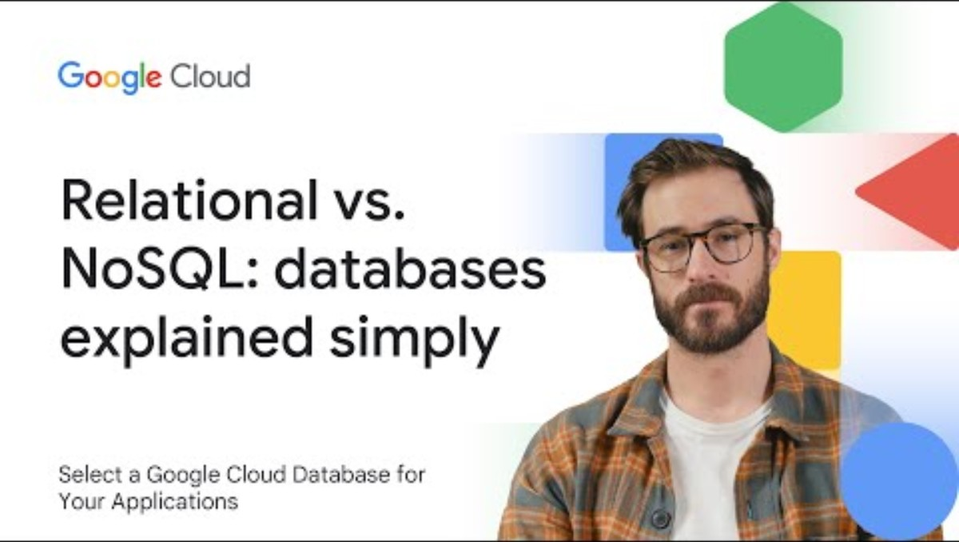
Google Cloud (2025, March 26). Relational vs. NoSQL: databases explained simply [Video]. YouTube. https://youtu.be/R0XlH8FUEc8?si=fVy7BC1bCg8isjn6

Slide 31
Non-Relational (NoSQL) Databases
NoSQL (Not Only SQL): Uses flexible, non-table data models.
Handles large, fast-changing, or unstructured information.
Runs across many servers at once for easy scaling.
Ideal for web, gaming, and social media applications.
Useful when data are:
Unpredictable or constantly changing
Unstructured (social media, clickstreams, IoT sensors)
Spread across multiple regions
Common in E-commerce product catalogs, streaming services (Netflix, Spotify), online games and social platforms

Slide 32
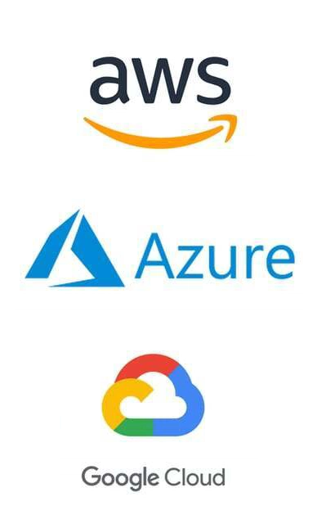
Cloud Databases
Cloud databases are hosted by external providers (AWS, Azure, Google Cloud).
Offer scalability, reliability, and pay-as-you-go pricing.
Lower entry costs for startups and small firms.
Support large AI or analytics workloads without building new infrastructure.
Some databases store data across many data centers.
Enables global firms to synchronize information across regions.
Users experience data as local, even when stored worldwide.
Reduces downtime and ensures consistency for global operations.
Distributed databases enable 24/7 global business continuity.

Slide 33
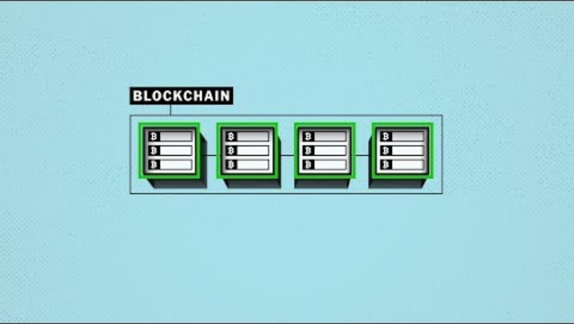
The New York Times (2018, April 2). How Cryptocurrency Works | NYT [Video]. YouTube. https://youtu.be/0B3sccDYwuI?si=j5DNxyxZC7ICtyKR

Slide 34
Blockchain
Blockchain is a distributed ledger shared across many computers.
Records transactions that can’t easily be altered once verified.
No central authority; all participants hold identical copies.
Each “block” links securely to the previous one through encryption.
Business uses of blockchain:
Supply chains: verify origin, shipping, and authenticity of goods.
Finance: secure payments and settlement (Bitcoin, Ethereum).
Healthcare: share medical records securely across providers.
Contracts: automate agreements via smart contracts.
For instance, IBM and Walmart use blockchain to trace food from farm to shelf in seconds.

Slide 35

Walmart (2018, September 24). Farming the Future: Harvesting Data on Blockchain [Video]. YouTube. https://youtu.be/js5CPfK1hCQ?si=Cz5rpuzBbUuwLxxe

Slide 36
Discussion #1
Why might a startup choose a cloud or NoSQL database instead of building its own system?
Potential Answers:
Lower Upfront Costs: No need to purchase expensive servers or hire database administrators.
Scalability: Cloud and NoSQL systems let startups expand quickly as data grow, without major infrastructure changes.
Speed to Market: Cloud services can be deployed in hours, not weeks.
Flexibility: NoSQL databases handle unstructured data like customer feedback, social media posts, and app usage logs.
Focus on Core Business: Startups can concentrate on product development and customers, not database maintenance.

Slide 37
Discussion #2
What trade-offs exist between flexibility, control, and security when adopting new data technologies?
Potential Answers:
Flexibility vs. Control: Cloud and NoSQL databases are highly flexible but reduce direct control since data are managed by third-party providers.
Security vs. Accessibility: Blockchain adds strong security and transparency but may be slower and more expensive to operate.
Customization vs. Standardization: Traditional relational systems are rigid but standardized while newer systems allow customization but require careful governance.
Cost vs. Capability: Cutting-edge solutions may offer advanced analytics or speed but come with subscription costs or specialized skill needs.
Managers must balance convenience and innovation with responsibility.

Slide 38
Tools Used to Analyze
Data in Databases

Slide 39
Why Analyze Data?
Databases record daily transactions: orders, payroll, suppliers, customers.
But business value comes from analyzing that data to guide decisions.
Managers ask:
Which products drive the most profit?
Which customers are most loyal?
Where are sales slowing down?
Data analysis turns information into actionable insight for planning, marketing, and operations.
Data management stores information; data analysis unlocks its value.

Slide 40
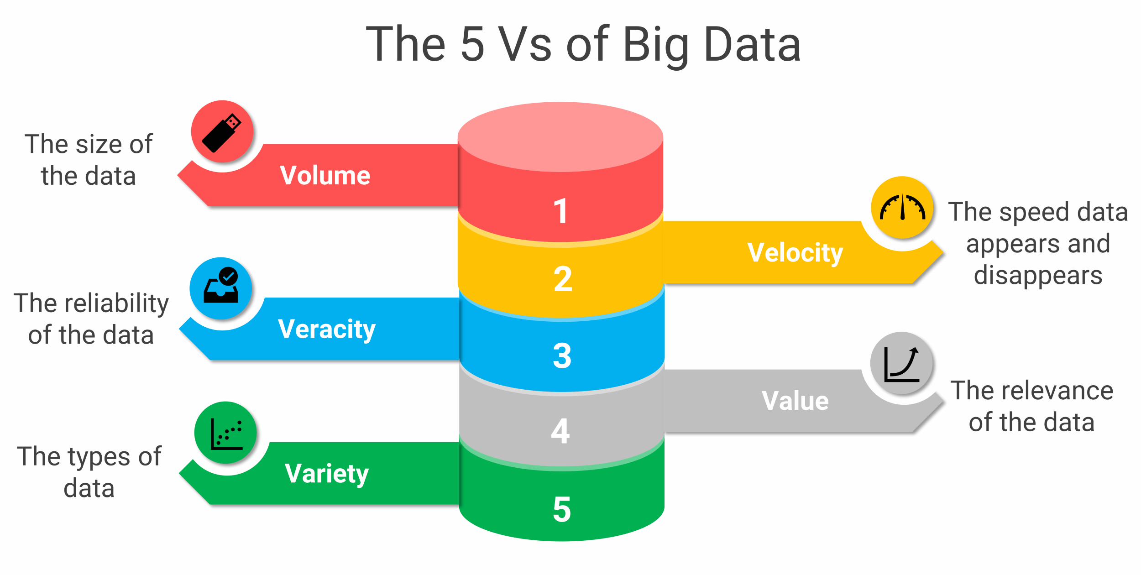
The Challenge of Big Data
Today’s organizations collect data far beyond transactions: website clicks, sensor readings, emails, videos, social-media posts.
Big Data is characterized by the 3Vs:
Volume: Huge size
Variety: Many formats
Velocity: Real-time speed
Plus 2V:
Value: Data’s usefulness
Veracity: Data quality
Example: Shutterstock analyzes 300 million+ images and user cursor movements to understand buying behavior.

Slide 41

Big Data and AI
Big data fuels Artificial Intelligence: Algorithms learn from massive data sets.
AI enhances big data analysis by recognizing patterns humans might miss.
Managers must define clear business questions before investing:
What problem will the data help solve?
How will success be measured?
The smartest systems are only as good as the questions they’re asked.

Slide 42
Business Intelligence (BI) Infrastructure
Business Intelligence (BI) integrates data from across the company to provide insights for decision making.
Core BI Components:
Data Warehouse: Central repository for cleaned and structured company data.
Data Mart: Targeted subset for departments or specific uses.
Data Lake: Raw, flexible storage for large or unstructured data.
Data Analytics Platforms: Dashboards, visualization, and reporting tools (e.g., Power BI, Looker).
Supporting Infrastructure:
Hadoop: Distributes and processes huge data sets across servers.
In-Memory Computing: Speeds up calculations and reporting by keeping data in RAM.

Slide 43
Warehouses, Marts, and Lakes: Organizing Data
Data Warehouse: “Accuracy”
Central, integrated collection of historical data from across departments.
Used for companywide reporting and long-term analysis.
e.g. Sales, inventory, and finance data combined to support forecasting.
Data Mart: “Focus”
Smaller, focused database for a specific function or team (e.g., Marketing, HR).
Faster and cheaper for targeted questions.
e.g. A marketing mart used to track campaign performance and ROI.
Data Lake: “Flexibility”
Stores massive volumes of raw data (structured and unstructured).
Keeps information in its original format until needed.
Used heavily in AI and machine learning applications.

Slide 44
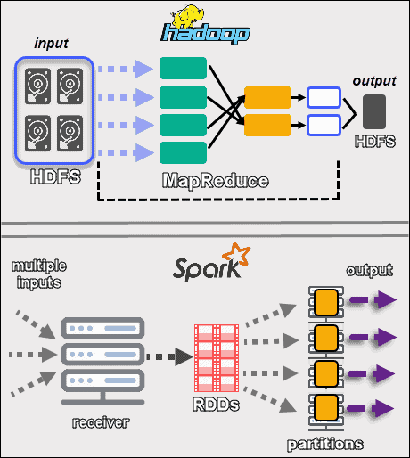
Hadoop and Spark: The Engines Behind Big Data
Hadoop:
Breaks huge data sets into smaller chunks and processes them across many low-cost servers.
Common in large firms like LinkedIn or Facebook.
Spark:
Performs similar processing, but in memory (RAM) for faster results.
Ideal for real-time analytics and streaming data.
Makes it possible to work with unstructured or massive-scale data
Think of them as the “factory machines” preparing data before it reaches dashboards or reports.

Slide 45
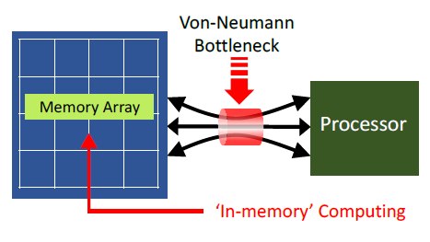
In-Memory Computing: Speed as an Advantage
Stores working data in RAM instead of disks, reducing lag time dramatically.
Enables near-instant queries, modeling, and forecasting, even on mobile devices.
Benefits:
Real-time dashboards and reporting.
Faster simulations and scenario planning.
Immediate decision support during meetings.
Faster access to data leads to faster reaction to market changes.

Slide 46
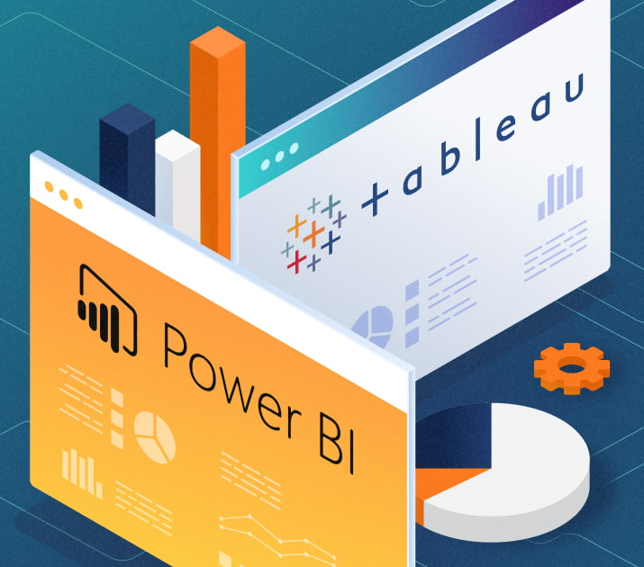
Analytics Platforms: Turning Data into Decisions
BI and analytics platforms bring data to life through dashboards, charts, and AI features.
Microsoft Power BI: Integrates with Excel and SharePoint; widely used for visualization.
Google Looker / Tableau: Interactive dashboards with drill-down and “natural language” search.
Used by all levels of management to:
Monitor KPIs and performance metrics.
Visualize trends and outliers.
Build a data-driven culture where evidence guides decisions.

Slide 47
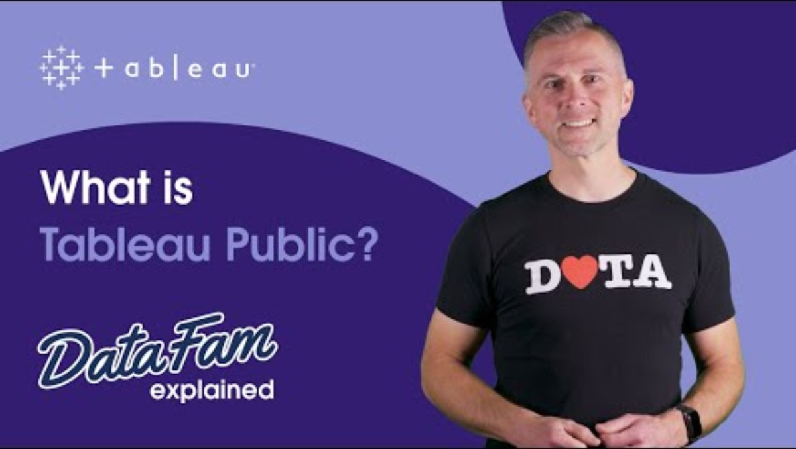
Tableau (2024, January 30). What is Tableau Public? | DataFam Explained [Video]. YouTube. https://youtu.be/3RjtQlrGInE?si=Uk2MT0xmRsHfItnk

Slide 48
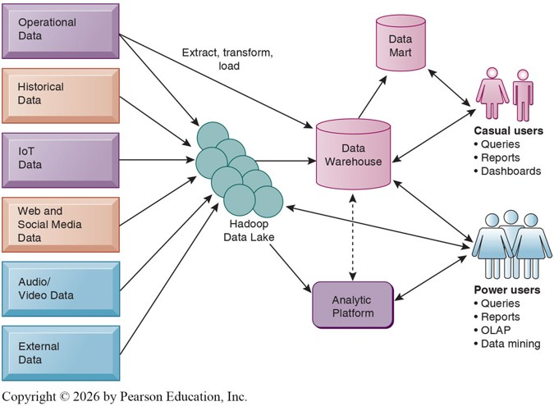
Contemporary Business Intelligence Technology Infrastructure

Slide 49
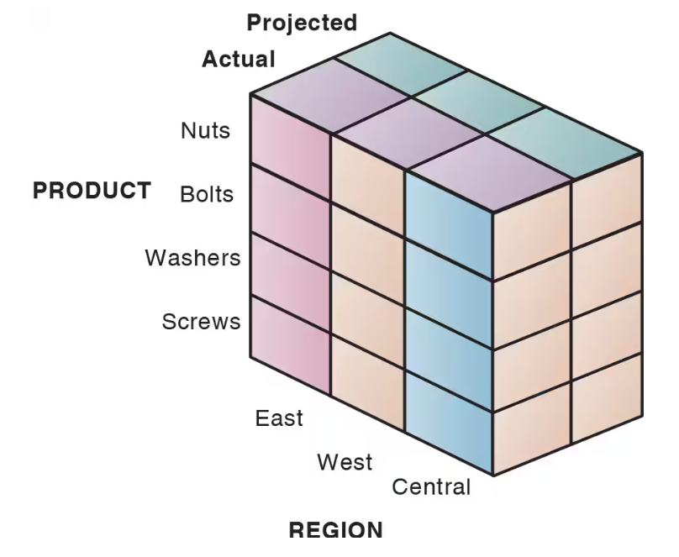
Online Analytical Processing (OLAP)
OLAP organizes data into “cubes” for quick comparisons.
Allows users to slice and dice data by product, region, time, or scenario.
e.g. “Compare Q3 sales of bolts in the East region vs. last year’s forecast.”
Supports multi-level analysis (by product line, territory, or time frame).
Analogy: “An advanced Excel PivotTable operating on companywide data.”

Slide 50

Data Mining
Goes beyond OLAP to find patterns and predict future outcomes.
Common Techniques:
Associations: Products often bought together (chips + soda).
Sequences: Events over time (buy a home → buy appliances).
Classification & Clustering: Group customers by demographics or behavior.
Forecasting: Estimate future sales or churn rates.
Data mining turns large data sets into practical actions and forecasts.

Slide 51
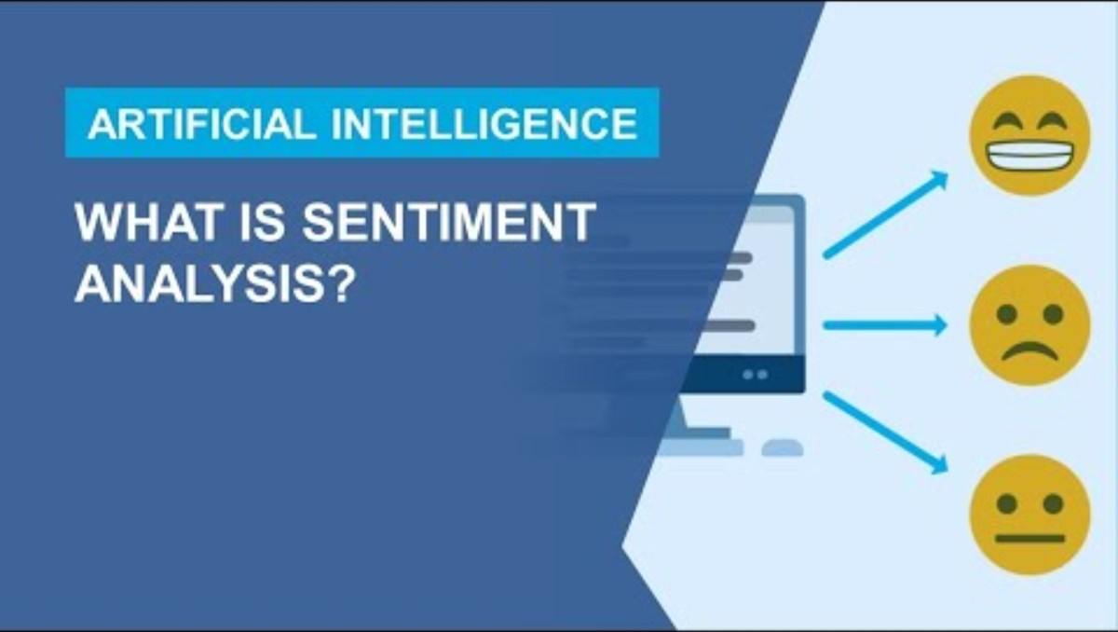
Matlab (2024, June 11). What Is Sentiment Analysis? [Video]. YouTube. https://youtu.be/hkwuaRdwEeI?si=XVP7zRs4SSzmJagv

Slide 52
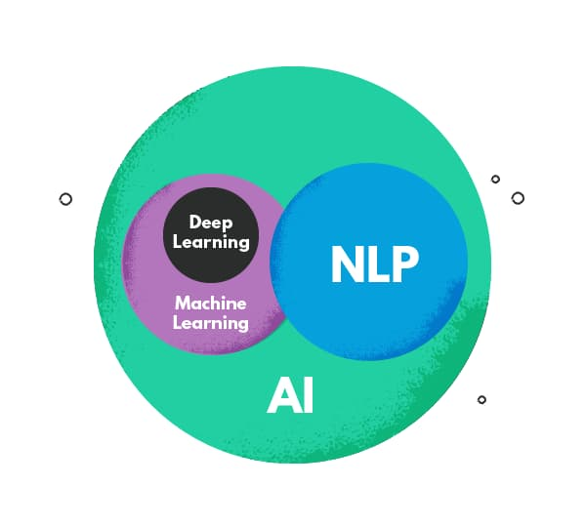
Data Mining: Text and Web Mining
Text Mining: Extracts meaning from documents, emails, chat logs, and surveys.
Sentiment Analysis: Uses AI to detect tone positive, negative, or neutral.
Web Mining: Examines site usage, clicks, and navigation patterns.
Purpose: Understand customer needs, brand perception, and online behavior.

Slide 53
Databases and the Web: Flow of Information
Modern websites and apps are directly connected to corporate databases.
How it Works:
Web or app → Web Server → Application Server → Database Server.
The system translates user actions (like searches or orders) into SQL queries.
Benefits:
Easy for customers to access live data (prices, inventory, order status).
Low-cost solution for expanding legacy systems online.
Online retailers, travel sites, and government portals all rely on this setup, and web-database integration enables 24/7 digital business operations.

Slide 54
Discussion #3
Where could text or web mining add value in a service-based business?
Potential Answers:
Text mining can analyze customer feedback from surveys, chat transcripts, or helpdesk logs to find recurring service problems.
Sentiment analysis of online reviews or social media posts can identify trends in satisfaction or frustration before they escalate.
Web mining can track how users navigate a company’s site to reveal where customers abandon sign-up or checkout processes.
e.g. A hotel chain could use text mining to find common complaints (“slow check-in”) and adjust training or staffing.

Slide 55
Data Governance, Data Quality Assurance,
and Data Management

Slide 56
Data Governance
Setting up a database is only the beginning, as managing data as a corporate asset requires rules and oversight.
Data Governance:
The framework of policies and procedures for handling data across the organization.
Defines who owns, updates, shares, and secures data.
Aligns data use with business goals, privacy laws, and ethical standards.
e.g. Only HR and Payroll staff can view or edit salary data; Marketing may view only anonymized summaries.
Data Governance = Accountability + Consistency + Security.

Slide 57
Key Elements of a Data Governance Policy
Ownership and Roles: Identify who maintains, validates, and approves data.
Access and Permissions: Define which users or departments can read, edit, or distribute information.
Standardization: Use consistent naming, codes, and formats across systems.
Security and Privacy: Ensure compliance with organizational and legal requirements.
Data Lifecycle Management: Establish rules for data collection, retention, and deletion.

Slide 58
Assuring Data Quality
Even the best databases fail if their data are inaccurate or inconsistent.
Common data quality issues:
Duplicate or missing records (e.g., multiple customer entries).
Inconsistent formats (e.g., “XL” vs. “extra large”).
Outdated or incorrectly entered data.
Consequences:
Faulty analysis, poor decisions, compliance violations, and financial losses.
e.g: Monte Carlo (2023) found that >50% of firms lose 25% of revenue due to poor data quality.
Bad data is more expensive than good governance.

Slide 59
How Companies Improve Data Quality
Data Quality Audit:
Systematic review of accuracy and completeness.
Surveys samples, users, or full datasets to locate errors.
Data Cleansing (Scrubbing):
Detect and correct mistakes (misspellings, transposed numbers, invalid codes).
Enforce consistency across departments and systems.
Prevention:
Train employees and customers entering data.
Standardize data definitions and input forms.
The goal is to stop errors before they spread through reporting systems or analytics tools.

Slide 60

BBC News (2020, October 5). “Lives at risk” as UK government confirms thousands of Covid cases missed in data blunder - BBC News [Video]. YouTube. https://youtu.be/Jk-HXWtOAJc?si=2KdLktduTSbeUYvh

Slide 61
AI and the Future of Data Management
Managing data at scale is time-consuming, but AI is now automating parts of the process.
AI applications (see Table 6.3):
Classification: Extracting structured data from images, documents, or video.
Cataloguing: Automatically locating and tagging data sources.
Data Quality Assurance: Identifying missing or suspicious values.
Security: Detecting unauthorized access and predicting threats.
Data Integration: Merging records from multiple systems.
Data Analysis: Finding complex patterns and generating insights.
AI’s value lies in its speed, scale, and error reduction, but still needs human oversight.

Slide 62
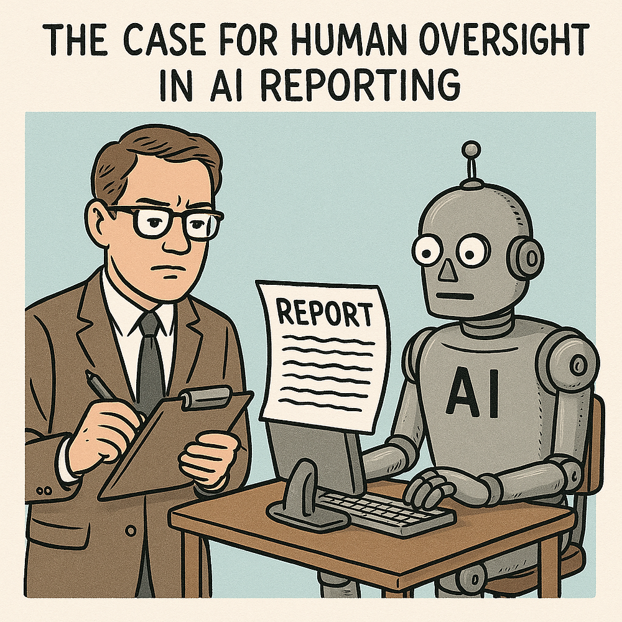
Why Humans Still Matter
AI can support data management but cannot replace judgment or accountability.
Managers Must:
Define clear governance policies.
Establish common definitions and ethical boundaries.
Verify and audit AI outputs.
Human oversight ensures that automation remains aligned with business priorities and regulatory compliance.
AI enhances data management, and people ensure it’s used responsibly.

Slide 63
Discussion #4
What’s the cost of poor data quality in your organization or an example you know?
Potential Answers:
Operational inefficiency: Duplicate customer records leads to wasted mailings, billing errors, or lost orders.
Financial losses: Incorrect pricing or supplier information leads to margin shrinkage or inventory imbalances.
Compliance costs: Misreported financials or customer data leads to fines and remediation.
Reputation and customer trust: Wrong data (e.g., misdirected emails, outdated contact info) harms credibility.

Slide 64
Recap of Chapter 6

Slide 65
Recap of Chapter 6
Describe traditional file environment data management problems.
﻿Describe DBMS and relational DBMS capabilities.
﻿Discuss relational database design principles.
﻿Describe non-relational, cloud, and blockchain database capabilities.
﻿Describe tools used to analyze data in databases.
﻿Discuss data governance, data quality assurance, and data management.

